Slide 1
Pension Fund Governance Who is the most central and influential?
Iman van Lelyveld Michael Rose Mark van der Voort 31 March 2016

Slide 2
Pension Fund Governance
Core Question: what is the influence of the network of pension fund governance?
Shared board members can either be a force for good – transferring knowledge – or for bad – channeling herd behaviour.
Main researcher is Michael Rose (University of Capetown) in cooperation with TP, TB Pf, THI_ECIS
Data: 1) Customer Relationship Management system (CRM) and 2) “Staten”
2 goals:
Web interface to explore relationships
Performance = f(PF characteristics, Board network measures)

Slide 3
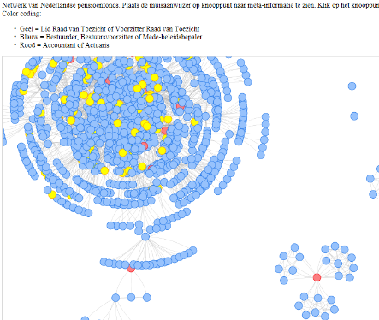
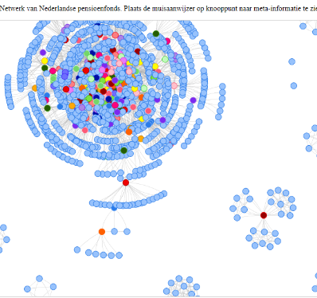
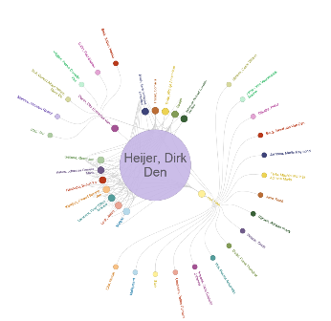
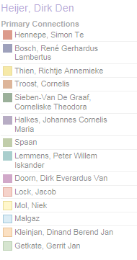

4 different views
CRM – Full ntw with function
CRM – Full ntw with centrality
CRM – Individual
Staten – Full ntw
Notes:
G:\TB\BKB\pfntw\Website\CRM_function.html
G:\TB\BKB\pfntw\Website\CRM_betweenness.html
G:\TB\BKB\pfntw\Website\CRM_function_ring.html
G:\TB\BKB\pfntw\Website\2014_function.html

Slide 4
We can identify the most central players
…
…
…
……
……
……
……

Slide 5
Going forward
Underway: finish proof of concept, adding pf and individual selectors
Possible uses:
Improving the quality of CRM
Identifying the most influential players
Extending this analysis to everyone in CRM (12500 functions)
Does the network influence outcomes: do board members or actuaries (e.g. WTW) influence the risks taken by pfs in the change over to the NFTK?

